Slide 1

WEB Development Internship
At SEMS Group

Slide 2
Introduction
SEMS Web Solutions is a Start-up & professional Company working in IT solutions, Marketing, Consultancy, Education, Employability & Entrepreneurship for various clients and partners servicing pan India
SEMS Web strongly believes in Women & Youth Empowerment and has conducted awareness program in Digital and Financial literacy, Digital Marketing, Career Development in various industries like Travel & Tourism, Construction, Retail, Finance, Apparel, Handicraft, Food Processing across states of Rajasthan, Haryana, Uttar Pradesh and Uttarakhand impacting the lives of over 5000 participants.

Slide 3
Objective
To Gain Knowledge
Learn About Front End and Backend of the NGO Donation Page Employment Management Application
To Enhance the communication skills
To Learn Framework Angular-js
For the coding, design and layout of a website according to a company's specifications
Know HTML, CSS, JavaScript and other relevant web design coding languages.
Create and test applications for websites.
Collaborate.
Present design specs.
Work with graphics and other designers.
Troubleshoot website problems.
Maintain and update websites.

Slide 4
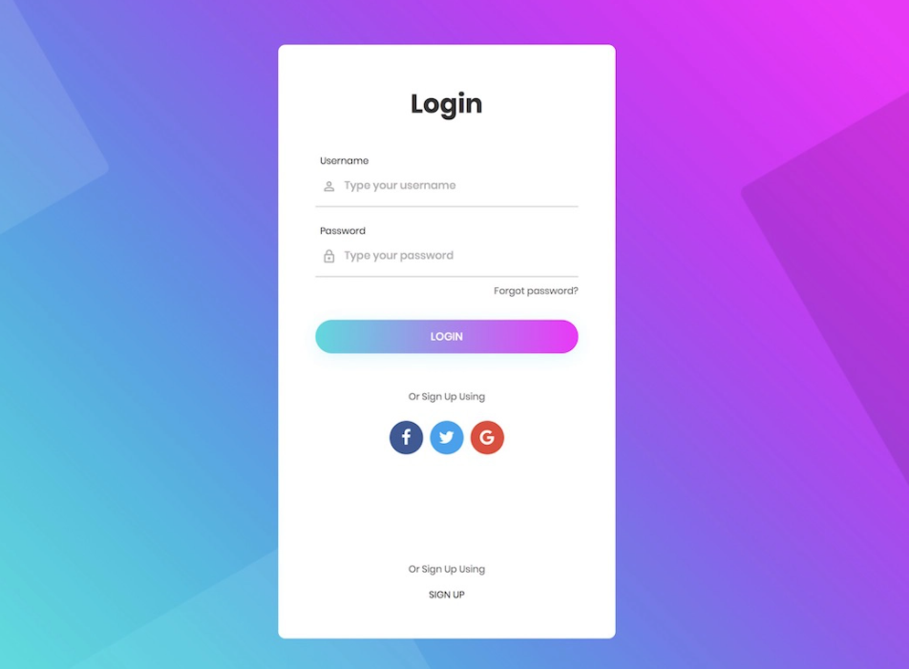
Log In page

Slide 5
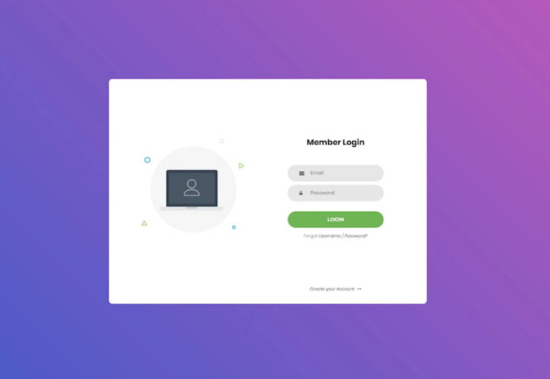
Member Login

Slide 6
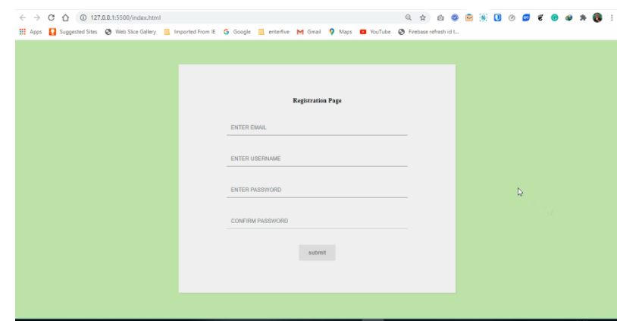
Registration Page

Slide 7

Food Donation Page

Slide 8
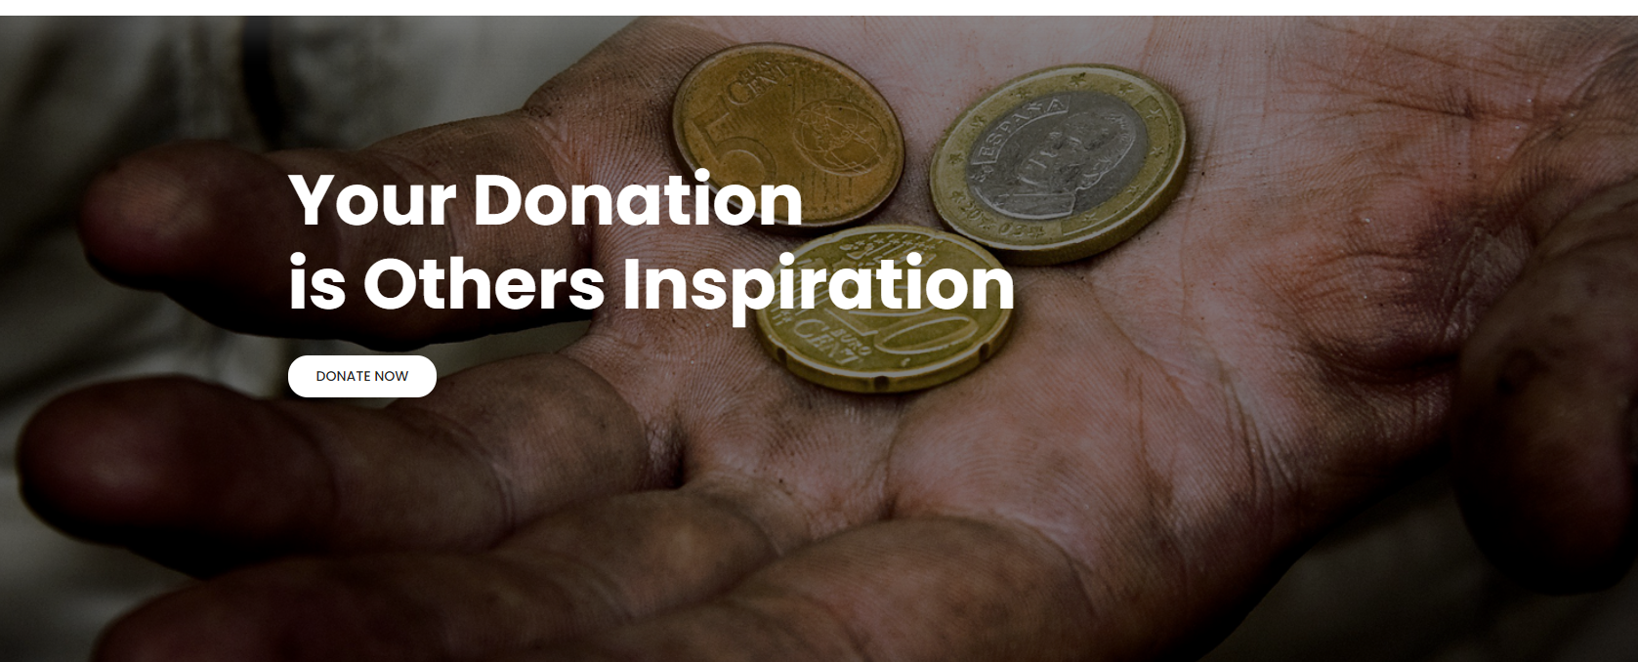
Donation

Slide 9
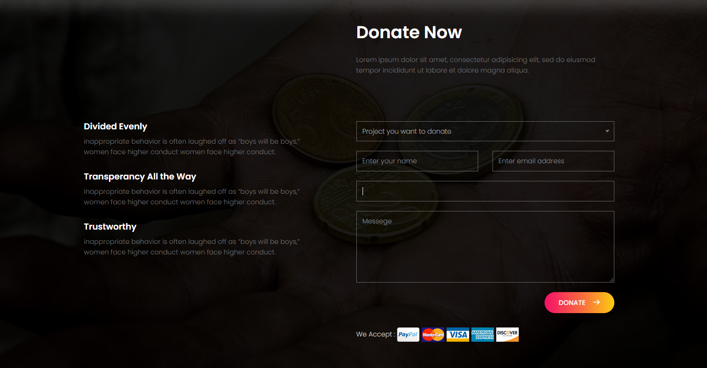
Final Payment Page

Slide 10
Thank YoU

